Slide 1
Introduction to Data Science Data Mining for Business Analytics
Brian d’Alessandro
Adjunct Professor, NYU
Fall 2015
Fine Print: these slides are, and always will be a work in progress. The material presented herein is original, inspired, or borrowed from others’ work. Where possible, attribution and acknowledgement will be made to content’s original source. Do not distribute, except for as needed as a pedagogical tool in the subject of Data Science.
Notes:
https://www.youtube.com/watch?v=aMDe5pODkB0 (harlan harris)

Slide 2
Model selection
Notes:
The goal of finding structure is to information from one source to reduce uncertainty about another source.
What does this mean? Conditional distribution example. I.e., carnival guy who guesses your weight. If I can see your height I can reduce uncertainty about weight.
Find some height/weight data.
Under supervised exploration:
How can we (automatically) obtain a selection of the more informative variables with respect to predicting the value of the target variable?
Even better, can we obtain the ranking of the variables?
Can think of importance as one that makes the target variable more pure. This leads to the notion of entropy.

Slide 3

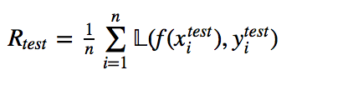
Goals of evaluation
The goal of evaluation in model building can be put quite simply: achieve the best generalization performance while avoiding overfitting.
Remember, in ERM we seek a function f(X) that minimizes the training error (or risk) on our training data.
WE ALWAYS want to measure the error on a holdout, or test set, too.
We can only be certain our models generalize if we do a correct holdout evaluation. Theory helps us design good algorithms with strong generalization and convergence results, but empirical hold-out testing is always necessary.

Slide 4
Model selection
When we model, we have many choices. We use holdout evaluation methodologies to optimize the following:
Algorithm Selection
(i.e., RF vs. Decision Tree vs. Logistic Regression vs. SVM)
Feature Selection
Hyper-parameter Selection, i.e.,
“k” in k-NN
“C” in SVM
MaxDepth, MinLeafSize in Decision Trees
Regularization Strength
The optimal configuration of these elements depends on the goals of the problem, which define an appropriate evaluation metric.

Slide 5
Basic design
When doing any sort of model selection, one usually begins by creating 3 splits of the data.
Training: the training data is used to find the optimal function given the model structure (i.e., fixed algorithm, feature set, hyper-parameters).
Training Data
Validation: the validation data is used to evaluate the loss/risk for a given model configuration. The configuration with the best loss/risk is selected as the final model
Validation
Data
Test
Data
Test: test data is not used for any parameter or model selection. It is only used as a generalization measure.

Slide 6
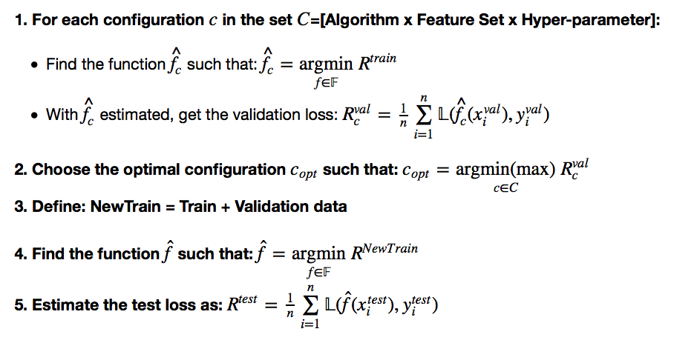
Example model selection routine
Define: Training Data
Define: Validation Data
Define: Test Data

Slide 7
Some notes on validation risk
The validation loss metric does not have to be the same as the training loss.
Sometimes we need a loss metric for an application that is not very easy or even possible to directly minimize.
I.e., we use logistic-loss to find f but we really need a loss metric that enables optimal ranking (such as AUC)
We might want to minimize a training loss metric, but maximize the validation metric (again logistic-loss vs. AUC)

Slide 8
Cross-validation
Sometimes we don’t have enough data to do a single train/validation/test split.
We can “recycle” data by using k-fold cross validation as our validation scheme.
Fold 1
Fold 2
Fold 3
…
Fold k-1
Fold k

Slide 9
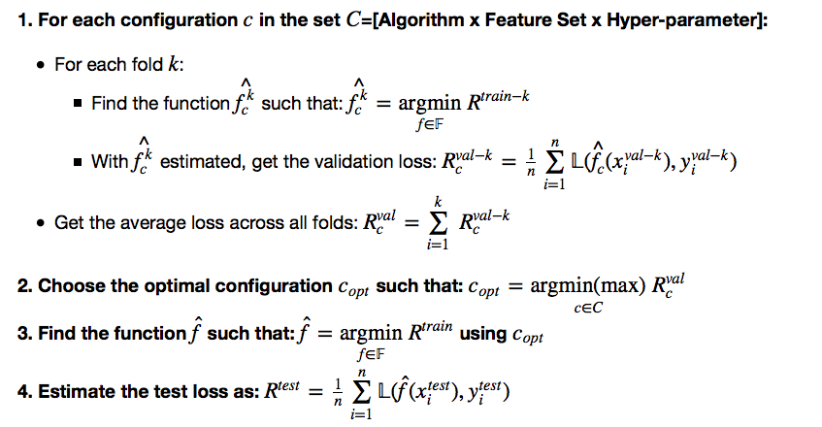
Example x-validation scheme
Define: Training Data
Define: Test Data

Slide 10
Some x-val notes
How should we choose split size or k?
There is no golden rule that defines how big training, validation and test sets should be.
You want each data set to be big enough to reduce the variance of your estimates.
Estimation variance comes in two flavors – variance of the function being fit to the training data and variance of the estimate of the validation/test risk.
Good heuristics are 50%/25%/25% for train/val/test splits and k=5 or 10 for x-validation.
Also, data should be randomly split with no overlap in instances between sets.

Slide 11
Estimation variance
Care should always be taken to reduce the variance in the estimation of validation/test risk as well as the optimal function f.
Variance is driven by two factors.
Training/Fit:
As the ratio of the the complexity of the model to the size of the training data increases, the model is likely to overfit, and this increases the variance of the model.
Small Test/Validation Sets:
- The test/validation risk is a mean of the per-sample risk across the data set. The standard error of the mean estimator decreases proportional to sqrt(n).

Slide 12
The bootstrap procedure
We can use the bootstrap procedure to empirically compute the variance of our estimators and incorporate the variance estimates into our selection mechanisms.
The Bootstrap Procedure:
Given original dataset Dº of size n, sample with replacement n times into a new dataset D^{b}.
2. Perform estimation process on D^{b}.
3. Repeat m times
4. Compute mean/variance over m estimation steps
Dº
D^{b}

Slide 13
Example model selection
We have a dataset with 14 features, roughly 10k examples and only 253 positive examples.
Goal
Build a classifier that has good ranking properties.
Solution
We’ll use Logistic Regression because it is robust in small-sample sizes and imbalanced classes, and also returns a score instead of just label predictions
With small data we expect high variance, so we need to use regularization
We’ll split data into 80/20 train/test and run 10-fold xvalidation on train.
We’ll use AUC to choose a regularization weight
We’ll bootstrap the test set estimate of AUC to get an empirical measure of its variance

Slide 14
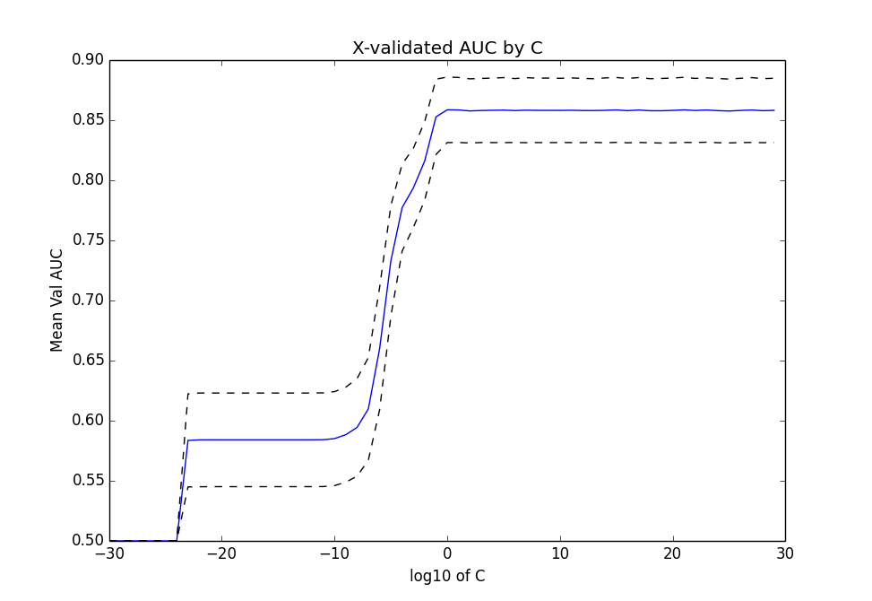
Results of xvalidation
With less regularization we actually do better here (strong signal in the features). But we still see that between 1 to 10³⁰ we get nearly the same results. It would be better if we can zoom into the region where performance is better.

Slide 15
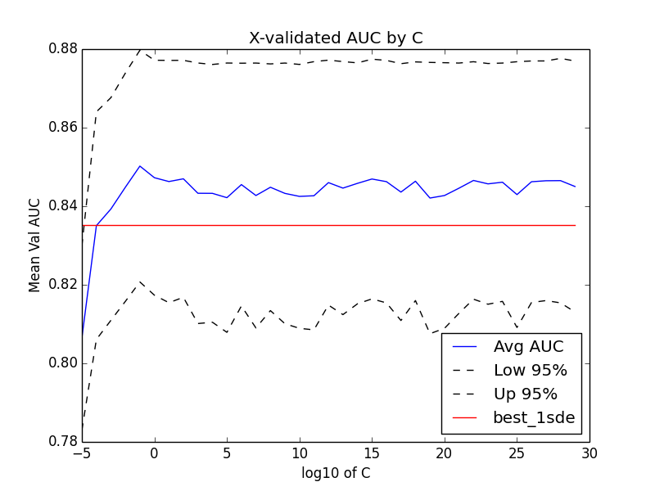
Results of xvalidation -zoomed
When we zoom in we can see that statistically speaking, everything above C=1 is essentially the same (i.e., strongly overlapping confidence intervals). There are two ways to choose C here.
Criteria 1:
Choose option with
max(Xval AUC)
Best Criteria 1
Criteria 2:
Find all options where
AUC>=max(AUC) – 1stderror
Choose least complex option (highest regularization)
Best Criteria 2

Slide 16
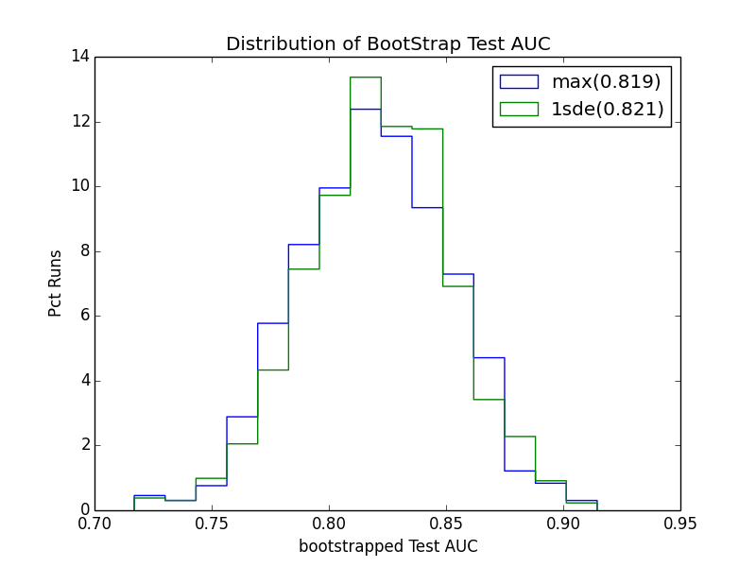
Bootstrapped out-of-sample
Now that we’ve selected the model hyper-parameters, let’s look at the test error. To get a sense of the variance, we run bootstrap analysis. In real situations, we wouldn’t use the test set to choose which selection criteria is better, but we can use it to construct 95% confidence intervals of our test error.

